Slide 1


OSO Token of Love & x402
The Non-Pecuniary 'Joyfork' Protocol
From Payment Required to Gratitude Accepted

Slide 2

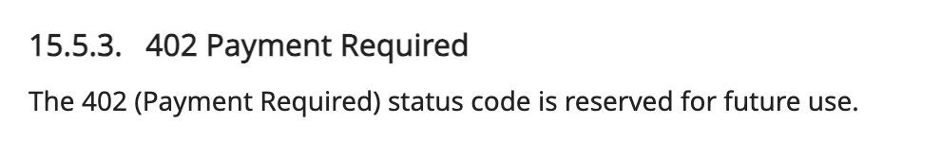
A Brief History of HTTP 402
That’s the entire standard.

Slide 3
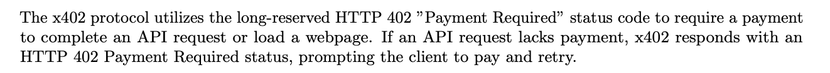
The Webhook Nature (1/2)

Slide 4
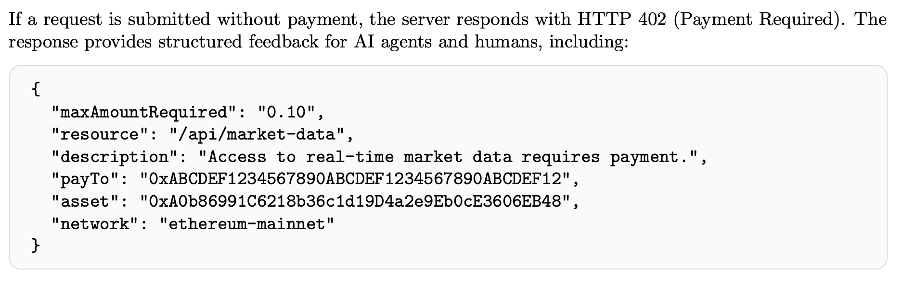
The Webhook Nature (2/2)

Slide 5


Liquity V2 'Joyfork'
Friendly Forks vs. Happy Forks
Friendly Fork (e.g., Nerite):
Licensed, serious financial protocol.
Redemption = Stablecoin -> Collateral ($ to $).
Joyfork (OSO):
A divergence in purpose.
Redemption = Token of Love -> Nothing Monetary.
We burn the token to create 'Flow' (Stream of Memories).

Slide 6

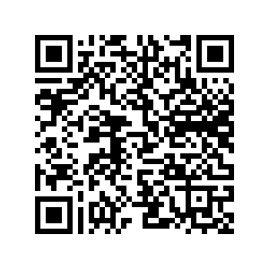
The OSO Vision
Token of Love Streams
* Closed-Loop Economy of Gratitude:
1. Creation: Audience gifts 'Love' (Tokens).
2. Usage: Robot 'spends' Love to work (x402).
3. Redemption: Tokens are burned to create a permanent record.
* Result:
- The robot runs on vibes.
- A protocol for the AI Agent economy.

